Slide 1

Choose the platform.
Keep the requirements.
Northbridge Components
200 agents
Synthetic procurement scenario
31 October 2026

Slide 2
Four gates. No trade-offs.
$180,000
EU + SSO
Year-one subscription + implementation ceiling
EU hosting at signature; production SSO
12 weeks
Complete migration
Production migration from signature
Tickets, customers, attachments
Estimates are not contractual commitments. No legacy archive agreed.
02

Slide 3
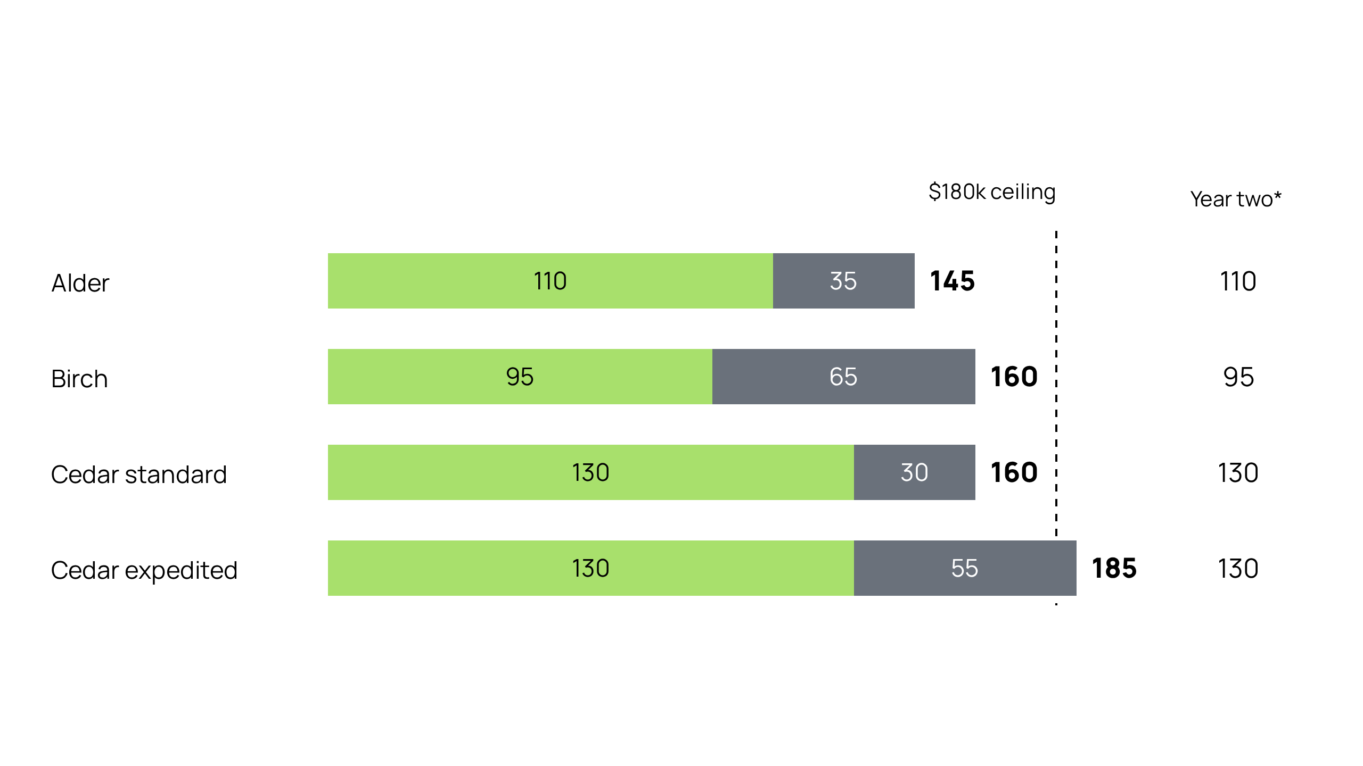
Alder has the lowest quoted year-one cost
USD thousands · 200 named seats · Subscription + Implementation
*Subscription only, before unagreed renewal changes. Taxes and usage overages excluded.
03

Slide 4
Only Alder potentially clears the gates
Alder
$145k · 10 weeks · EU + SSO stated
Birch
Fails EU hosting
Cedar standard
14 weeks exceeds deadline
Cedar expedited
$185k exceeds budget
Supplier statements, not validated compliance.
04

Slide 5
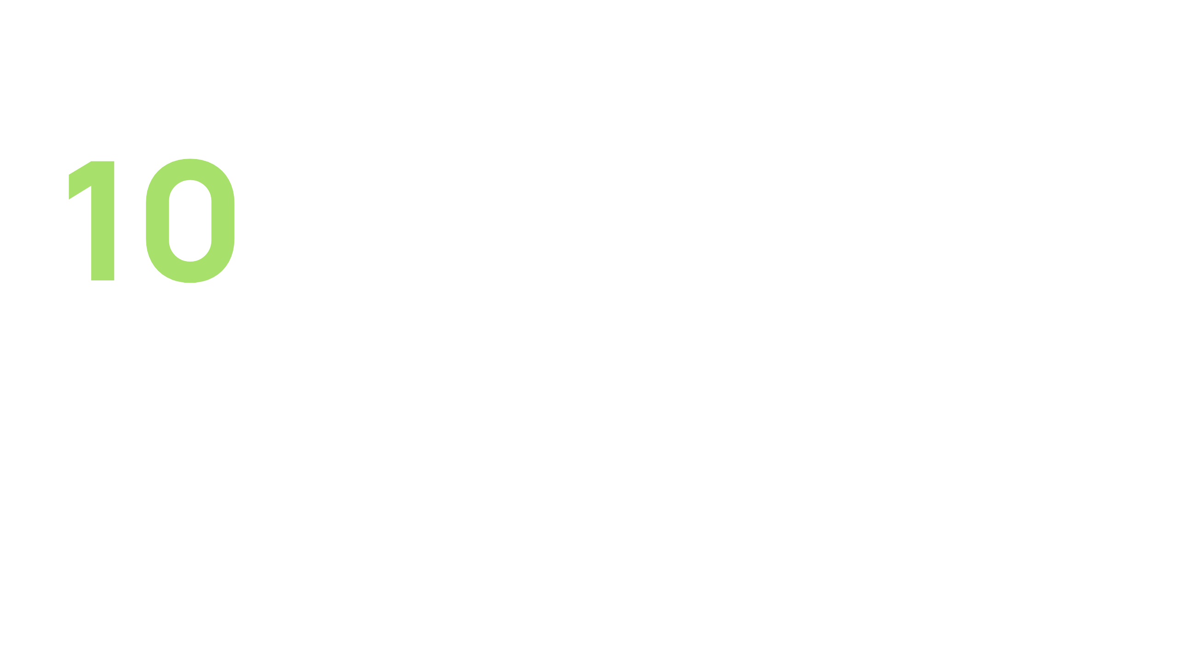
Ten weeks is an estimate, not a commitment
weeks estimated
2 weeks nominal headroom
Ready source data
Mapping decisions:
five business days
One rehearsal
All suppliers: unsigned milestones; ERP connector untested.
05

Slide 6
Attachments remain Alder’s exit risk
Records
Attachments
Export API
Manual
admin workflow
Automated bulk export excluded
Test migration in and export out separately: completeness, effort, fees, acceptance.
Cedar lacks end-to-end export evidence; superiority is unproven.
06

Slide 7
Close four gates before signature
IT / Security
Operations / Migration
Validate EU hosting, data flows, SSO, security.
Test attachments, migration, export; agree acceptance.
Finance / Procurement
Programme / Supplier
Validate allowance against 18,000-ticket/month workload; confirm overages, taxes, limits.
Resource contractual 12-week completion; test ERP.
07

Slide 8

Prefer Alder.
Award only after validation.
If gates fail, return to leadership.
No automatic substitution.
Synthetic procurement scenario

