Slide 1

AI risk in support.
A field guide to
customer outcomes.

Slide 2
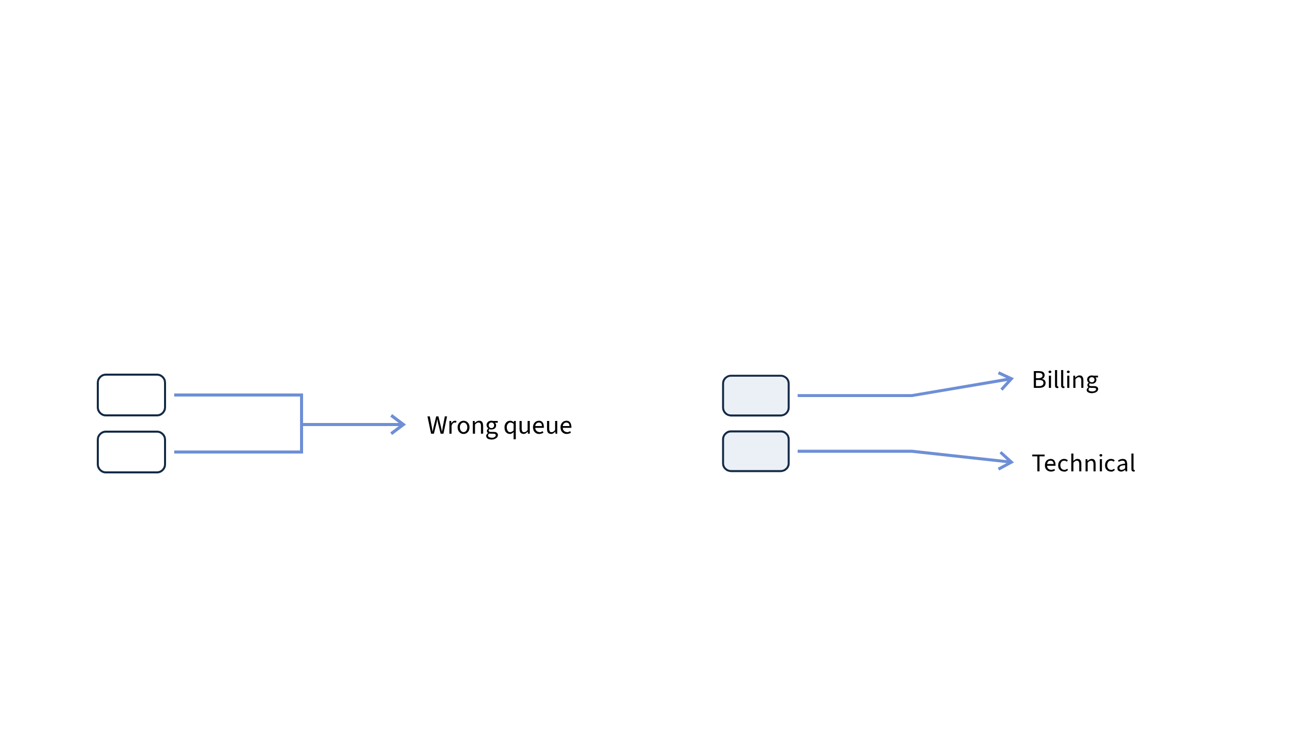
Familiar harms.
Less predictable failures.
Fixed routing rule
AI classifier
Faulty conditions repeat errors.
Unfamiliar wording shifts routing.
AI adds uncertain outputs, data dependence and human overreliance.
Both delay service. Reviewers can compound errors.

Slide 3
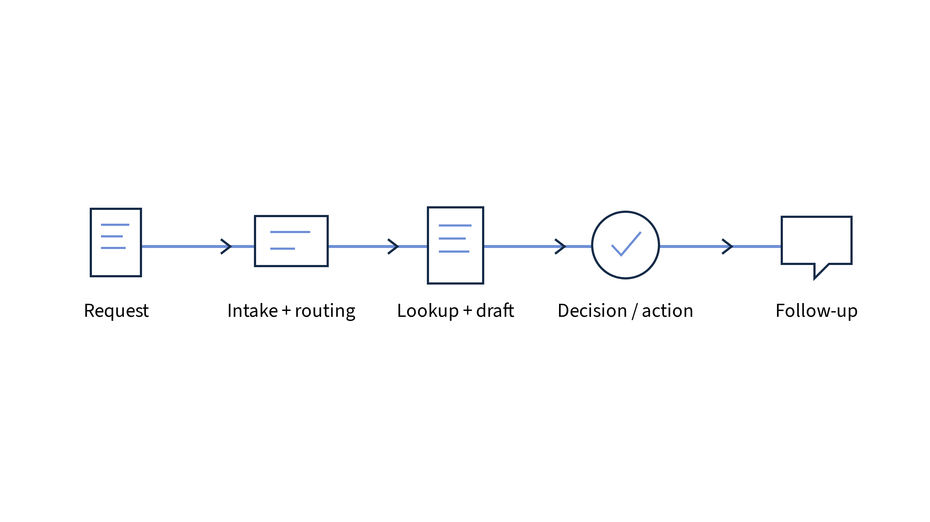
Follow the request.
Track the authority.
AI advises →
Acts after approval →
Acts autonomously
At each handoff: data? permissions? reviewer? human access?

Slide 4
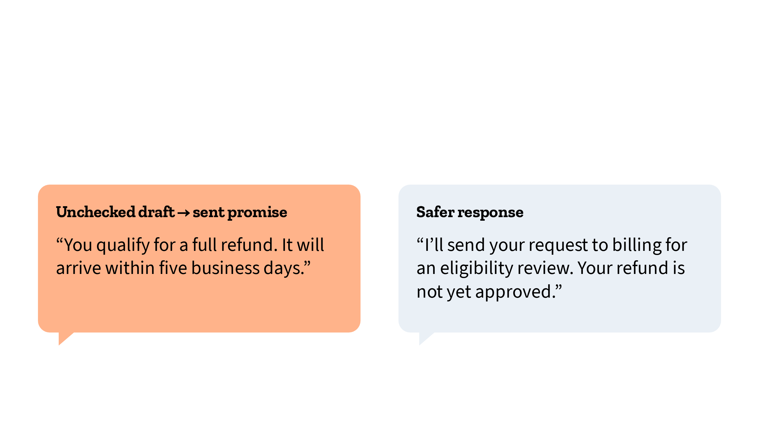
Where a draft
becomes a promise.
Illustrative refund case
Company rule: Billing reviews eligibility before support promises approval.

Slide 5
Turn a failure into a risk decision
Failure
Unapproved refund promised
Impact
Customer disputes; corrective work
Likelihood
Test realistic requests and exceptions
Exposure
Which channels and decisions?
Uncertainty
What remains untested?
Prioritize likelihood and impact. Unknown is not low risk.
Restrict commitments until controls are tested.

Slide 6
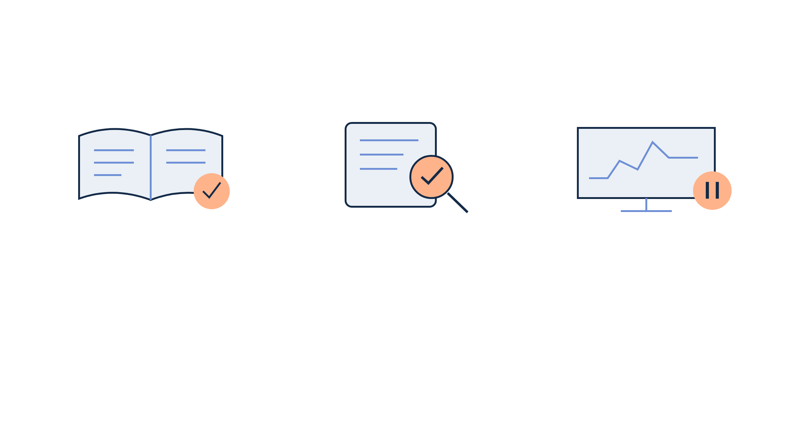
Safeguard the consequential handoffs
Before drafting
Before sending / acting
During operation
Current policy
Minimal customer data
Restricted access
Check facts and authority
Escalate eligibility
Block unauthorized actions
Test; monitor failures
Human handoff
Disable automation
Document the risk that remains.

Slide 7

Keep the workflow under review
GOVERN
Owner, authority, escalation throughout
MAP
MEASURE
MANAGE
Task, data, customers
and potential harms
Realistic tests, errors,
feedback and overrides
Prioritize fixes,
restrict uses, recover
Continuous functions, not a one-way checklist.

Slide 8

Start bounded.
Expand with evidence.
One workflow. One owner. Clear launch and pause criteria.

