Slide 1

Synthetic example
Cedarline Logistics
Renewal
worth reviewing.
$144,000 ARR
Due 30 November 2026
June–August 2026 evidence

Slide 2
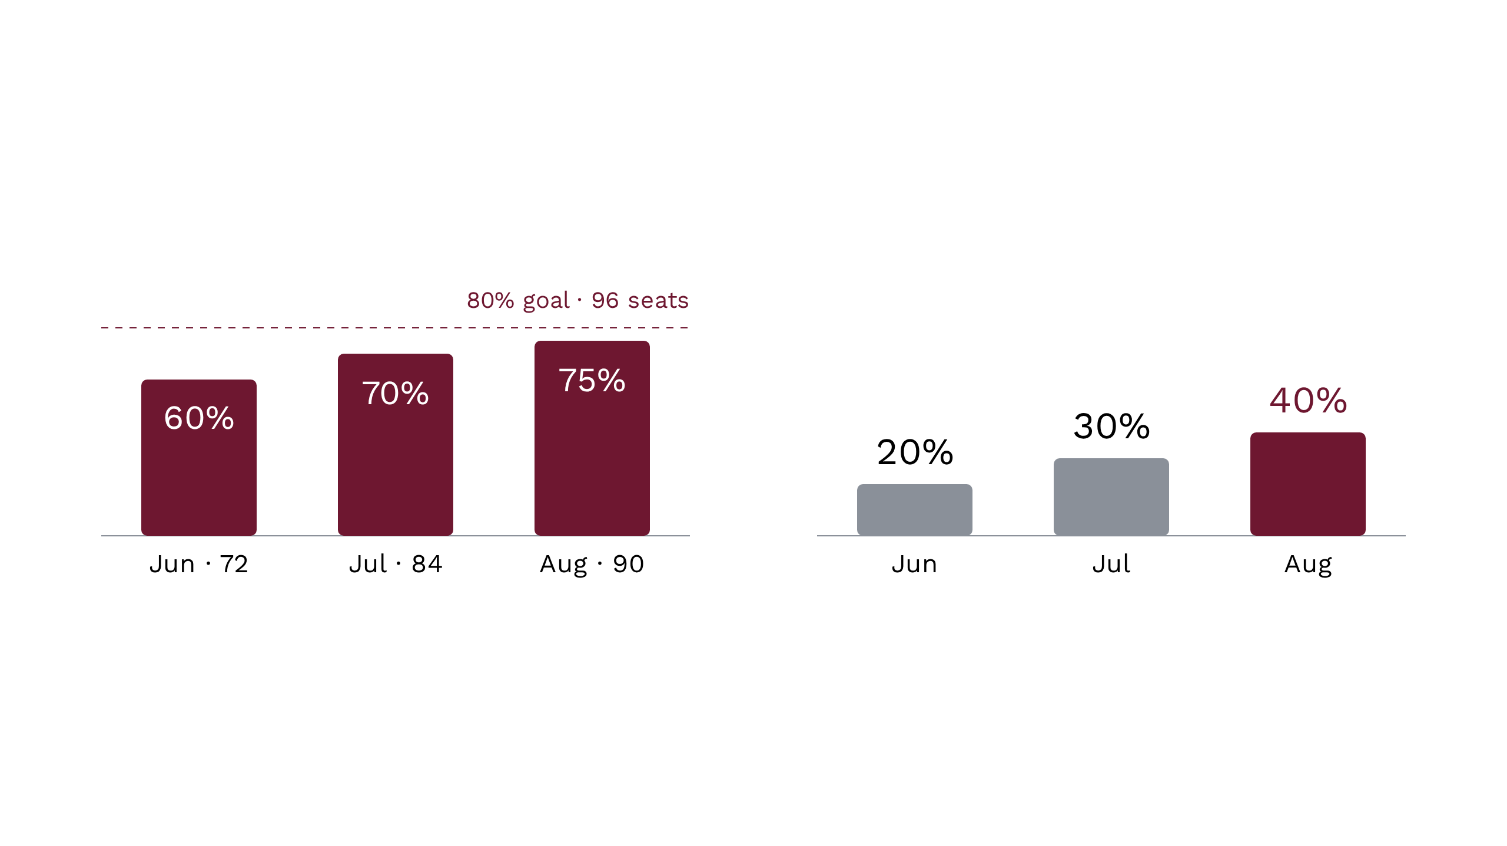
Usage grew. Adoption still trails the goal.
Active seats / 120 licensed
Eligible-ticket coverage
August: six active seats below goal.
Coverage counts eligible tickets with ≥1 pilot workflow, once per ticket. June–August 2026.
02

Slide 3
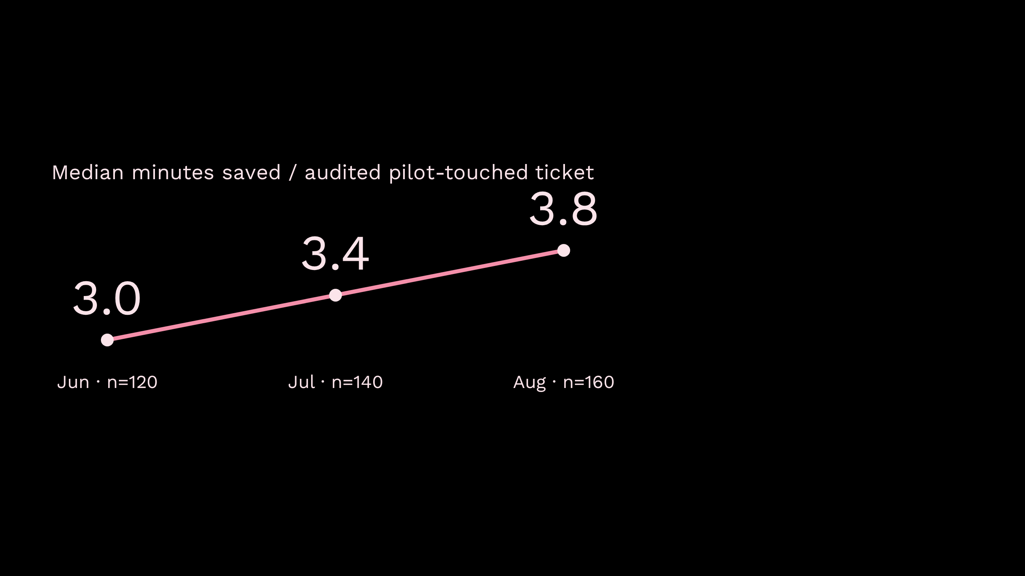
Promising signals. Not validated total ROI.
2 → 1 → 0
P1 incidents
June–August 2026
Not a reliability guarantee.
CSAT changes are not attributable to the pilot.
Manually selected samples; insufficient review/rework accounting prevents extrapolating total hours or monetary ROI.

Slide 4
Close the gaps behind the averages.
01
Night-shift adoption
Uneven use; training reduces queue coverage.
Coaching delivery owner unassigned.
02
Exception handling
Mixed-language checks add work.
Account for review and rework.
03
Operational resilience
Check fallback runbook status.
Assign after-hours drill ownership.
04

Slide 5
Two scopes. Separate decisions.
Existing renewal
Proposed expansion
$144,000
+40 seats
Unpriced; no approved quote,
commitment or purchase order.
ARR · 120 licensed seats
Due 30 November 2026
No decision date agreed.
Approval not recorded.
Recommendation: progress renewal review without bundling expansion.
05

Slide 6
Past working dates need a status check.
As of 31 October 2026: completion is not established.
11 September
Maya
Confirm coaching owner
18 September
Omar
Draft fallback runbook
25 September
Leo / Maya
Audit design / scope approval
15 October
Nina
Draft renewal evidence pack
Unconfirmed
Priya
Procurement review slot
Confirm evidence of completion, or reset owner and date.
06

Slide 7
Four decisions requested today.
1
Confirm renewal path
2
Assign owners
Approvers and procurement slot
before 30 November 2026.
Coaching delivery and
after-hours drill.
3
Agree evidence
4
Defer expansion
Audit scope including
exception review and rework.
Revisit 40 seats after
an agreed evidence checkpoint.
Proposed decisions, not recorded agreements.

Slide 8

Advance the review.
Not the commitment.
Existing renewal first. Expansion stays separate.
Confirm readiness before 30 November 2026

